Slide 1
SCC211 Operation System
(Memory Protect)
Zhang Jinyu – zjy@bjtu.edu.cn
School of Computer and Information Technology
SD408

Slide 2
Objectives
How to split memory between processes
Problems and techniques apply more generally
e.g. disks and filesystems
How to protect processes from each other
How to limit access to memory-mapped devices
Recall, privileged instructions ‘protect’ isolated I/O
Memory-mapped devices just seen as memory.
如何在进程之间分割内存
如何互相保护进程
如何限制对内存映射设备的访问

Slide 3
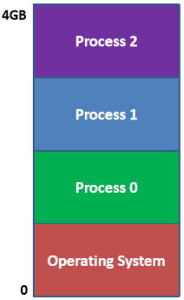
Operating System
Aim to run multiple jobs
Each given share of computer resources
Multiprogramming
Switches between processes as they become blocked (waiting for I/O, etc.)
Multitasking (time-sharing)
Regularly switch between processes so each appears interactive
分时，轮询

Slide 4
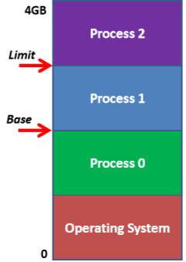
Simple Protection: Base and Limit
Need to protect processes from each other
For memory, can enforce Base and Limit
Easy to handle in hardware
Simple to set 2 registers in software

Slide 5
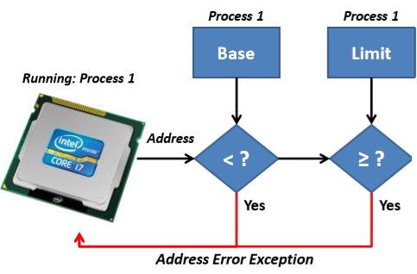
Base and Limit Handling
32位

Slide 6
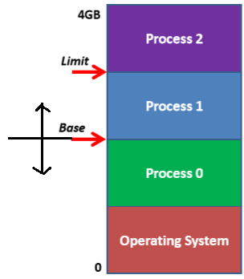
Separate Address Spaces
Processes expect zero based addresses
Base and Limit leaves location of process visible
Process can be loaded in different places
Addresses change between runs
Ideally we’d dynamically re-map addresses
Virtual Address
Process always sees addresses 0…n
Physical Address
Varies depending on where process loaded in memory
上下移动
base改变，limit固定
从0开始

Slide 7
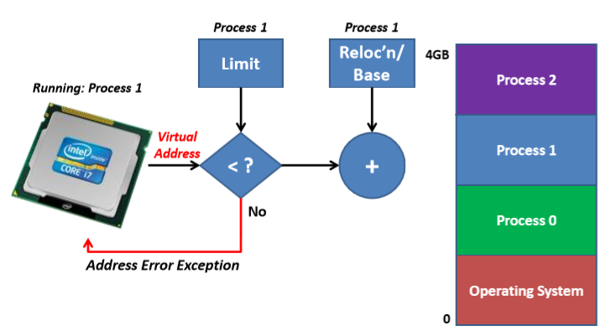
Relocation Registers
存在寄存器
Physical address
加上基地址
虚拟+基=物理

Slide 8
Memory management unit (MMU)
MMU
Physical address

Slide 9
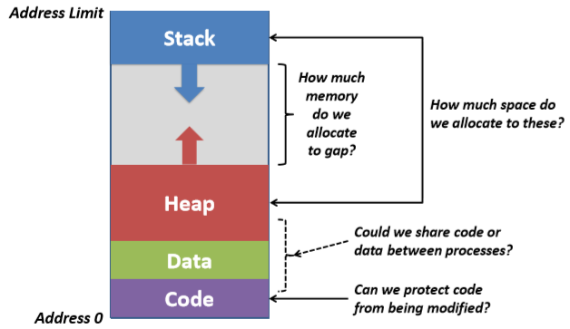
Some Simple Process Questions
base为堆，向上生长
limit为栈，向下生长

Slide 10
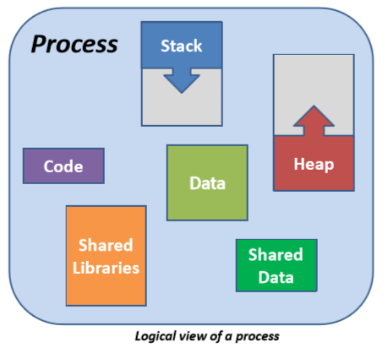
Segments

Slide 11
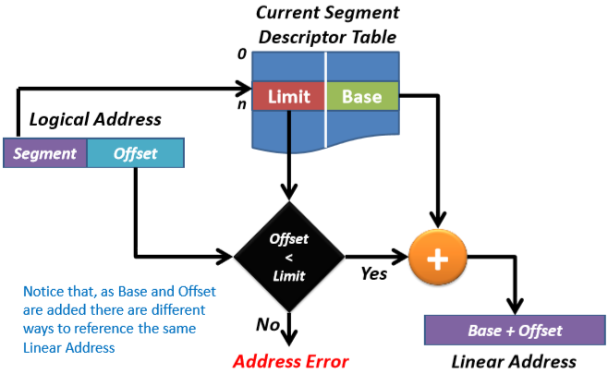
Segmentation
划分

Slide 12
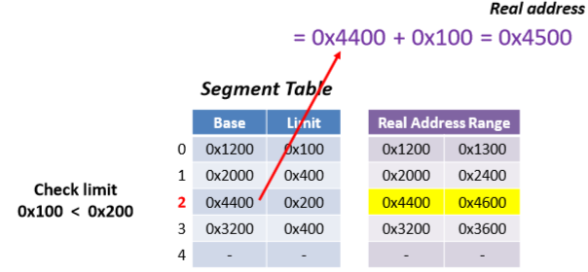
Segmentation
Notice instructions explicitly identify segment
JMP segment : address
JMP 2 : 0x100

Slide 13
Problem with Variable Size Region
Segmentation just one such scheme
Dynamic Storage Allocation Problem
First fit
Always allocate first region of sufficient size found
Best fit
Always allocate smallest memory hole of sufficient size
Worst fit
Always allocate largest memory hole (of sufficient size)
最坏
最好
首先满足
总是分配找到的第一个足够大小的区域
最适合．
总是分配足够大小的最小内存
最适合
总是分配最大的内存(足够大)

Slide 14
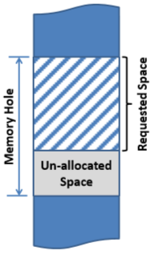
Fragmentation
会成为一个严重的问题
特别是在第一和最佳匹配方案中
未分配空间的总和可能很大
需要复杂的de-fragmentation
洗牌内存内容
必须对正在运行的进程不可见
在代码中使用内存引用，这可能是不可能的
“最适合”旨在减少问题
留下最大的未分配空间，以增加以后分配的机会
Can become severe problem
Especially in First- and Best- fit schemes
Sum of un-allocated space can be large
Requires complex de-fragmentation
Shuffling memory contents
Must be invisible to running processes
With memory references in code, likely impossible
Worst fit aims to reduce problem
Leaves largest un-allocated space
Aims to increase chance of later allocation

Slide 15
Variable vs. Fixed Sized Schemes
Variable/ Dynamic allocation schemes
Allocate requested amount of memory
External fragmentation
Space left outside/ between allocated memory
Fixed size schemes
Always allocate memory in fixed-sized blocks
Internal fragmentation
Processes typically get more memory than requested
This will generally remain unused
Much less of a problem than External Frag., as bounded by
Block allocation size
Process lifetime
动态：
分配要求大小的内存（外部）
外部的碎片
固定：
固定大小块（内部）
内部碎片
获得比期望更多的
问题相比更小
最多浪费一页
一旦退出，马上回收

Slide 16
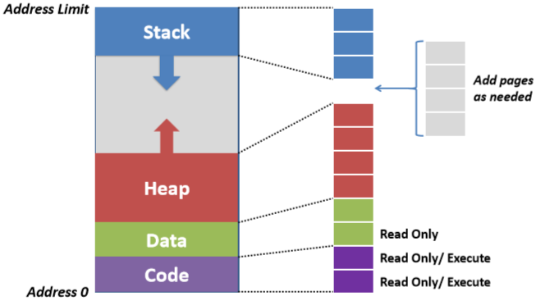
Fixed Sized Allocation: Paging
动态
分页

Slide 17
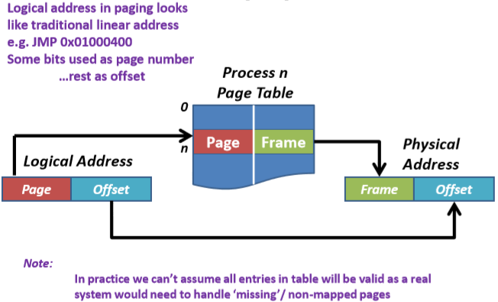
Paging
在页表中，通过页号获得帧号
多少页，多少行

Slide 18
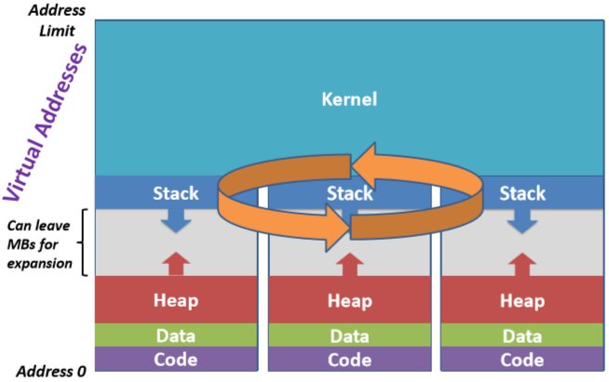
Kernel Typically Visible to all Processes
协调空间
一个进程

Slide 19
Question？

